Slide 1
Employee Data Analysis using Excel
STUDENT NAME:P.GANESH
REGISTER NO:312207112
DEPARTMENT:B.COM COMMERCE(GENERAL)
COLLEGE:AGURCHAND MANMULL JAIN COLLEGE
NM ID:37FB860D2DAA8AD8F104C5D40D5EDFE9

Slide 2
PROJECT TITLE
Employee Performance Analysis using Excel

Slide 3


AGENDA
Problem Statement
Project Overview
End Users
Our Solution and Proposition
Dataset Description
Modelling Approach
Results and Discussion
Conclusion
3/21/2024 Annual Review

Slide 4
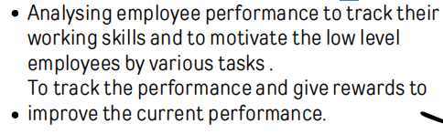

PROBLEM STATEMENT

Slide 5
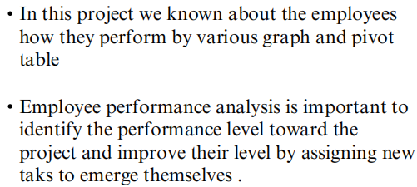

PROJECT OVERVIEW

Slide 6


WHO ARE THE END USERS?

Slide 7

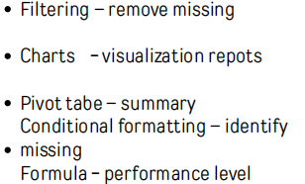
OUR SOLUTION AND ITS VALUE PROPOSITION

Slide 8
Dataset Description
Employee data set - the employee datas are taken from the Kaggle to analysis employe performance
9 features
Employee ID: Unique identifier for each employee in the organization.
First Name: The first name of the employee.
Title: The job title or position of the employee within the organization
.
.Business Unit: The specific business unit or department to which the employee belongs.
Employee Status: The current employment status of the employee (e.g., Active, On Leave, Terminated).
Employee Type: The type of employment the employee has (e.g., Full-time, Part-time, Contract)

Slide 9


THE "WOW" IN OUR SOLUTION
3/21/2024 Annual Review

Slide 10
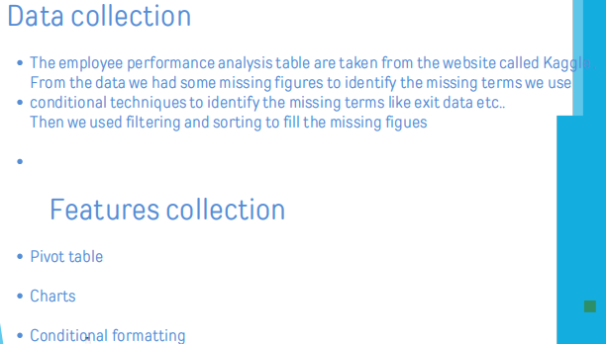
MODELLING

Slide 11
Pivot table
1.Click insert
2.From the insert bar click pivot table in new excel sheet
3.Select business unit and drag it in row
4.Then select performance level and drag it in column
5 . Select gender in value
PERFORMANCE LEVEL
From the pivot table we can see the analysis for female male and all and we can access all
type of employees by inerting slicers to see how many are full time ,part time and
contract based employees.
Insert graph for better analysis the graph shows the accurate levels and the
performance of employees. We can see the various graph by changing the options in the
graph options.

Slide 12
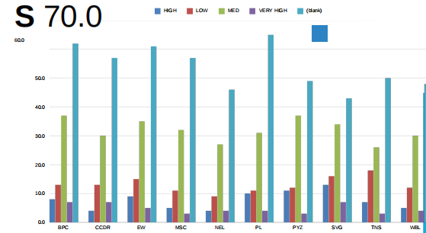
RESULTS

Slide 13
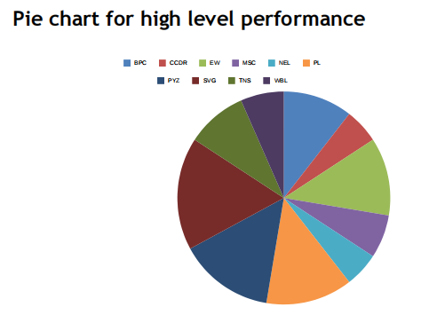

Slide 14
conclusion
From the above analysis the low level,medium level to be
improved by assigning various tasks and training in their
field
The current high and very high level employees are
improve their intensity by rewards and appreciations
towards their growth to increase their participation and
to give more potential towards their project

